Slide 1

Bayesian Hierarchical Modelling of Helium Signatures in Red Giant Stars
Joshua Cardrick
Partner: Dan Williams
Supervisor: Guy Davies

Slide 2
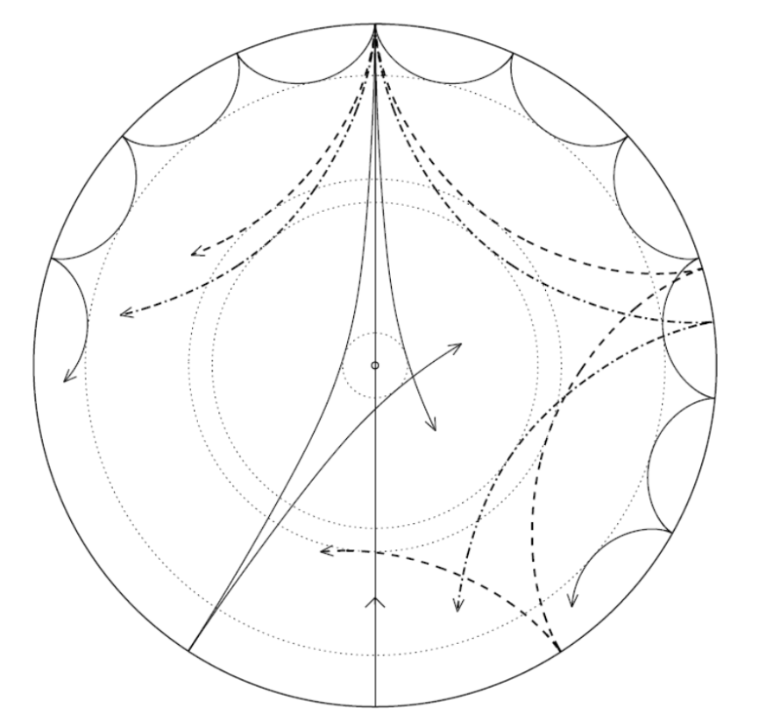
Background
Helium abundance
Cosmological models
Asteroseismology
P and G modes
Helium Glitch
HeII Ionisation region
Low angular degree modes penetrate deeper.
Diagram from Jørgen Christensen-Dalsgaard, Institut for Fysik og Astronomi, Aarhus Universitet, andTeoretisk Astrofysik Center, Danmarks Grundforskningsfond
Notes:
2nd most abundant element,
amount of Helium is poorly understood,
since the big bang, enrichment in stars increased helium
helium enrichment aid accurate design of cosmological models
modern asteroseismology techniques allow the probing of the internalcomp
Stars oscillate due to standing waves in the stellar interior
G mode - buoyancy
Pressure waves which in lower temp stars, propagate the core and most importantly the envelope

Slide 3
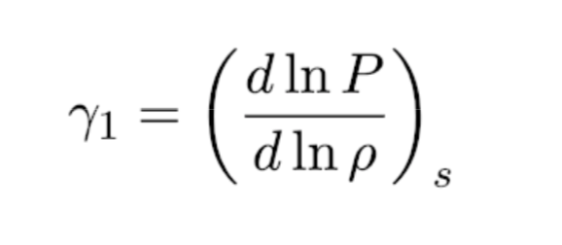
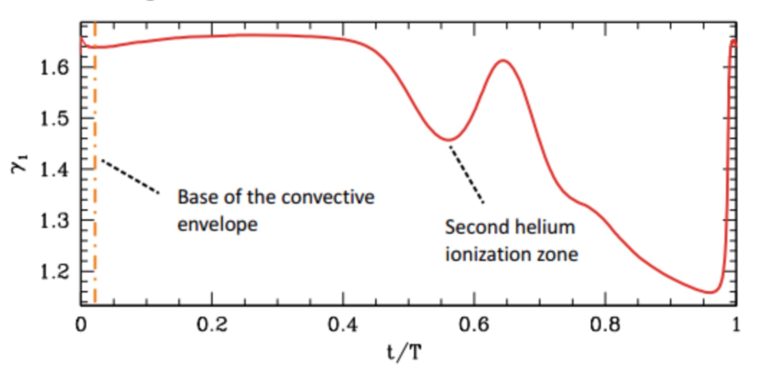
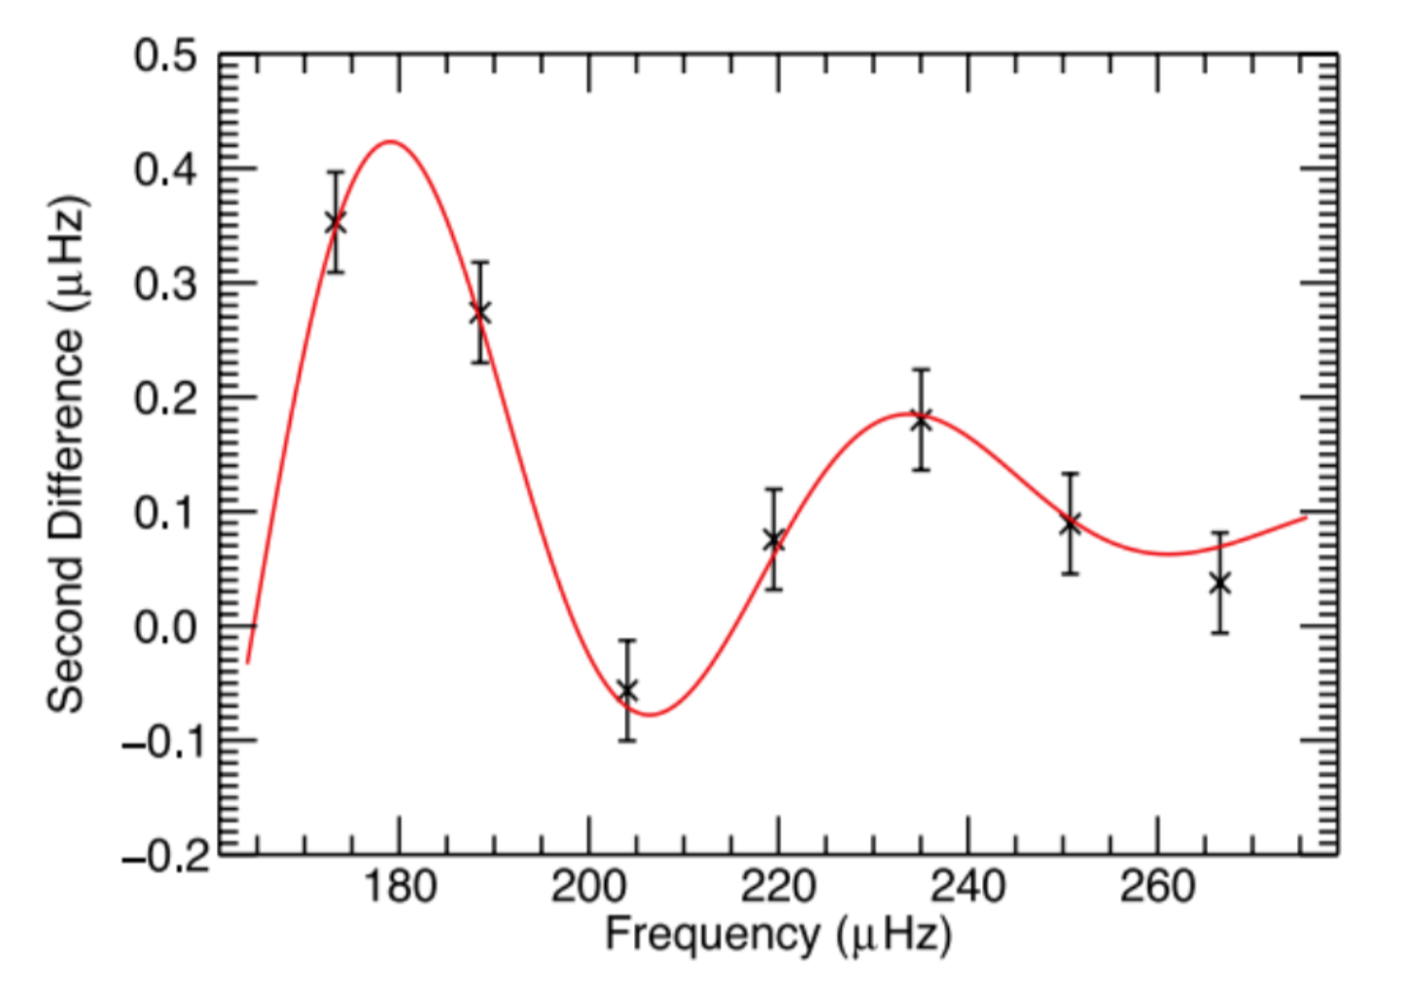
Helium Glitch
Notes:
HeII ionization zone causes a sharp deviation in composition, which can be described by the adiabatic component
Mainly occurs at the boundary of convective envelope, causing a shift in frequency of the lower order oscillations
This can be detected as an “acoustic glitch” in the oscillations, taking the form of a decaying sinusoid
the oscillation decreases with increasing spatial frequency
This occurs due to the wavelength of the mode becoming comparable or smaller in size to the glitch, so the mode becomes desensitised to its presence

Slide 4
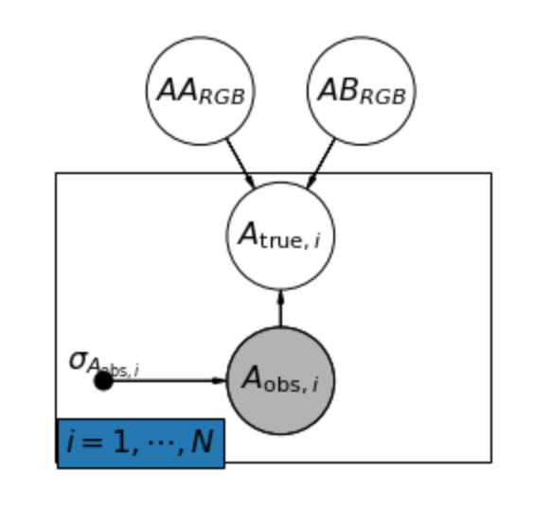
Method
Stan
1000+ stars
Began with solar data from BiSON
Kepler data
Acyclic graph visualising the structure of the Bayesian hierarchical model
Notes:
Glitch is small with high uncertainty
Leverage the power of the ensemble by using sample of 1000+ stars
Done by constructing a Bayesian hierarchical model to deduce the parameters
asymptotic expansion formula

Slide 5
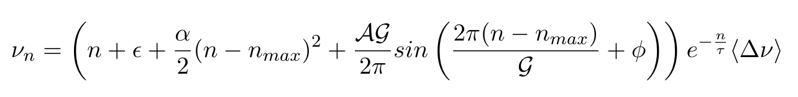
Stan
Statistical inference on parameters and hyperparameters
Power of the ensemble to reduce error
Asymptotic expansion from Vrard 2014
Notes:
As an unknown function, there are many forms the asymptotic expansion can take, here we use Vrard 2014 with an additional exponential decay term.
n is mode of oscillation, epsilon is asymptotic offset, alpha is the curvature term, A is the amplitude and G is the period and delNu is the average frequency spacing between successive modes
Use python to setup data and interface with stan
Stan is to provide statistical inference on the parameters, affecting the Helium glitch within red giants.
allows us to harness the power of the ensemble by inferring hyperparameters shared across many thousands of red giants.
This compensates for the large error associated with a single measurement of the solar-like oscillations of red giants.

Slide 6
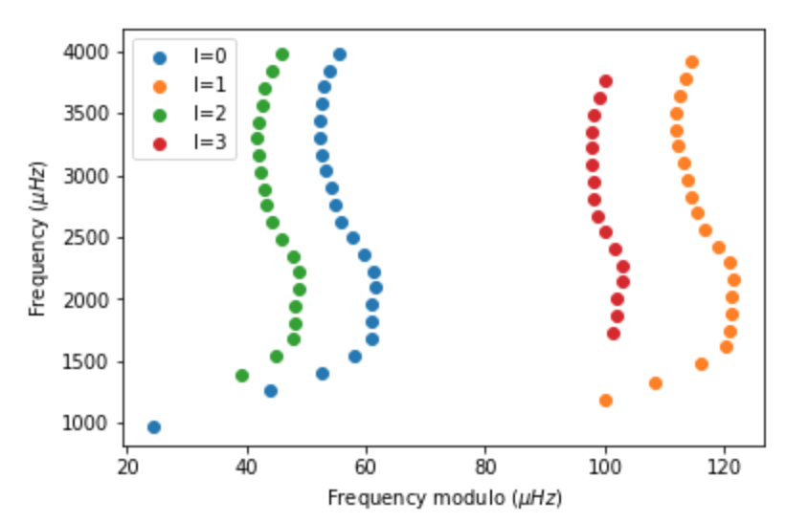
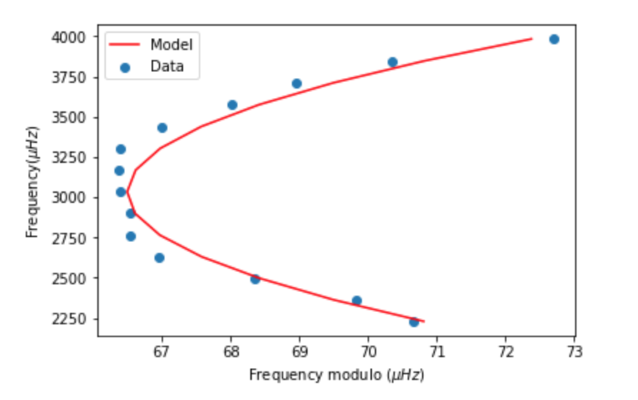
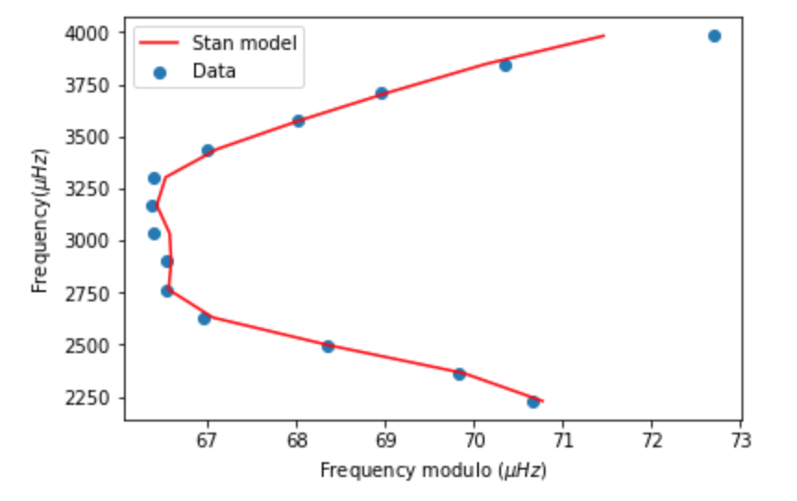
Solar Data
Notes:
We initially used data from the Birmingham Solar Oscillation Network to test our model on a single star
The data for successive angular degrees is plotted in an echelle diagram to show how the composition causes curvature of the echelle
With estimated parameters our model shows a decent fit, but after using stan to deduce the parameters the fit improved greatly

Slide 7
Kepler
Fixed field of view
Retired in October 2018 after 9 years
Transit Photometry
Red giants
Notes:
Kepler observes single patch of sky for four years, observing fluctuations in luminosity of stars in FOV
Retired in October, it’s 9 year orbit of the sun allowed it to observe many thousands of stars over long timescales
Its primary objective is to detect exoplanets by measuring the dip in intensity as they transit across the star,
Because of this Kepler measures the luminosity of many thousands of stars over a very long timescale, providing excellent data for asteroseismic analysis
We used the frequency and mode data to construct echelle diagrams of the l=0 angular degree as this penetrates the envelope of the stars

Slide 8
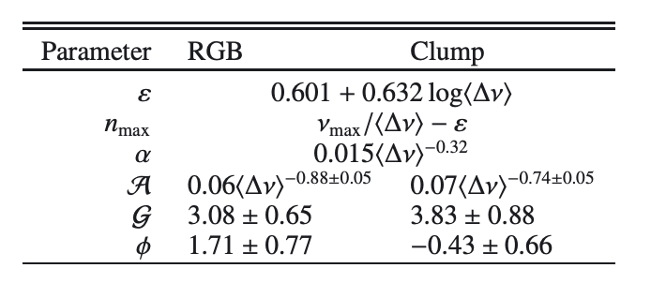
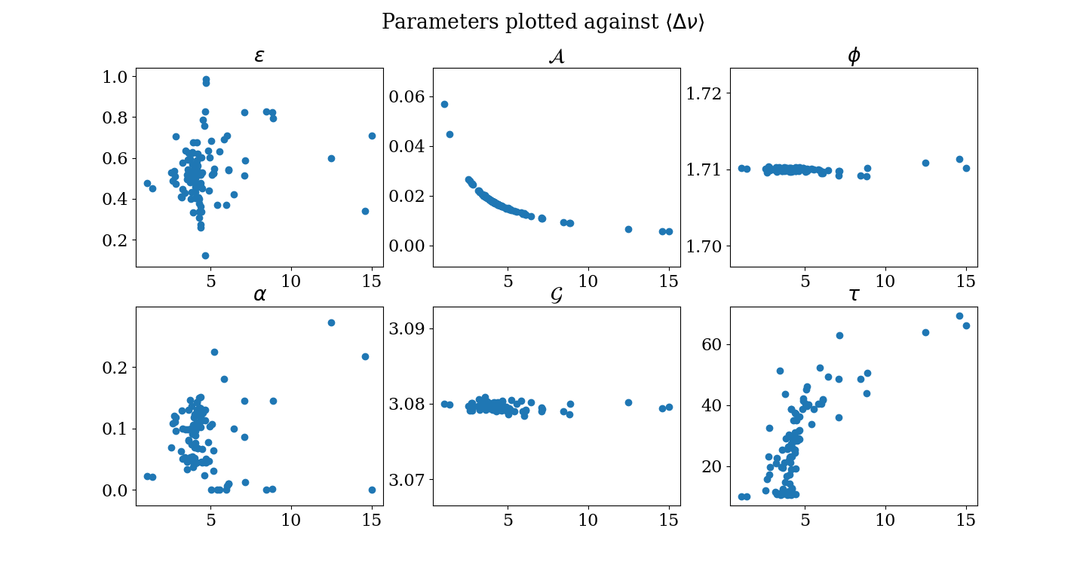
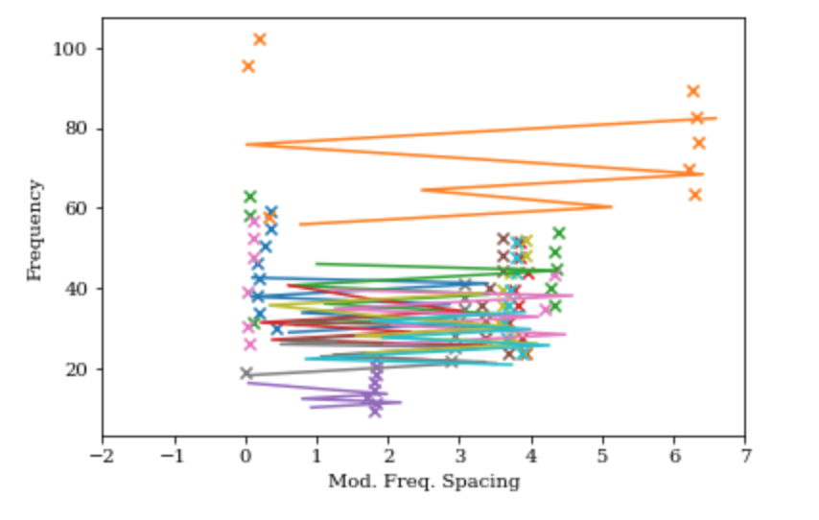
Current findings
Notes:
Currently have a functional HBM and incorporate as many stars as we wish, or laptop can handle, whose output seems to agree with Vrard 2014.

Slide 9
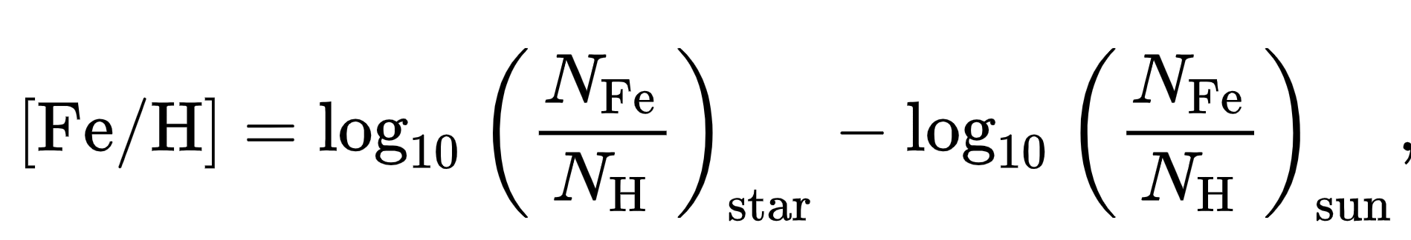
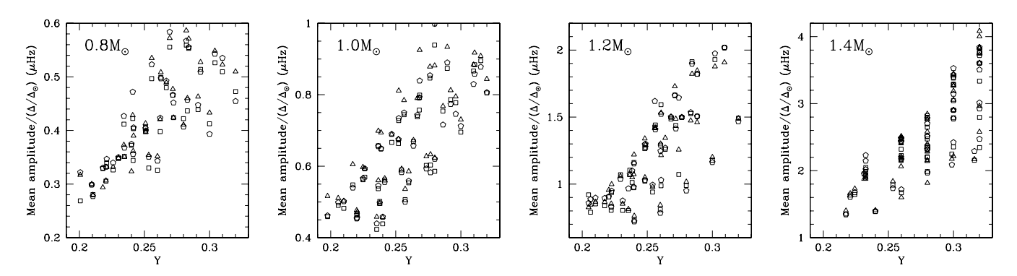
Predictions
Galactic chemical evolution models
Dependence on metallicity
Initial Mass Function
Star Formation Rate
The mean amplitude of the oscillatory part in frequency due to the He II ionization zone is shown as a function of the helium abundance in the envelope. Basu 2004
Notes:
If successful this project will result in constraint on the Helium enrichment within red giants and a better understanding of the Helium content of the galaxy
From GCEM most likely dependence upon metallicity, defined as the log ratio of heavy elements (metals) to hydrogen compared to the sun
Many models use galactic parameters such as the IMF and SFR to describe the development of elements in the galaxy
IMF is a metric to describe the initial distribution of mass within a cluster of stars
SFR being the total mass of stars formed in a year.
These evolutionary parameters could be incorporated into the determination of Helium enrichment

Slide 10

Further work
Improve accuracy of HBM
Analyse results
Compare to galactic chemical evolution models
PyChem
Notes:
Currently, our model can incorporate as many stars as we wish, providing inference on parameters to constrain Helium enrichment
Next steps are to improve the efficiency of our model by re-parameterising or using decomposition techniques
Once the program adequately converges on the desired parameters we can begin analysing the results qualitatively
At this point, we will compare our results to the chemical evolution models I mentioned previously
We can conceivably develop models using another python package called PyChem in order to tailor this model to our findings

Slide 11
Summary
Internal composition of stars
Understanding of galactic evolution
Currently developing model to provide accurate results
Notes:
Project has the potential to provide understanding of an area of astronomy that has only recently become accessible.
A tighter understanding the Helium abundance within red giants can improve models of internal composition and stellar and galactic evolution
Now that our model works for a small sample this can be grown and developed into harnessing data from many thousands to provide an accurate and important result

